Slide 1
Supplemental figures

Slide 2
Supplementary table 1. Selected genomewide genetic study references.
First author | Last author | Year | Cell lines | Method | Inclusion Threshold | # of genes
Bakke, J | Chen, T | 2019 | Pancreatic cancer: PANC-1 | CRISPRko | positive p-value < 0.05 | 43
Sack, LM | Elledge, SJ | 2018 | Pancreatic, breast, fibroblast | ORF library, positive selection | pvalue<0.05 & Log2FC< -1 & FDR< 0.05 in either cell line | 40
Sanson, KR | Doench, JG | 2018 | A375 melanoma, HT29 | CRISPRko, CRISPRi, CRISPRa | Only CRISPRa analysis provided; CRISPRa < 0, p-value <0.05 | 34
Wang, T | Sabatini, DM | 2017 | 14 human AML cell lines | CRISPRko | CS > 1 in any cell line | 6
Martincorena, I | Campbell, PJ | 2017 | 7,664 tumors across 29 | Molecular evolution | AML p-value < 0.05 or combined(all cancers) p-value < 0.05 | 9
Wallace, J | O’Connell, RM | 2016 | MV411 AML cell line, | GeCKO CRISPRi | p-value <0.05 and log2fc > 1 | 21
Horlbeck, MA | Weissman, JS | 2016 | K562 | CRISPRi/a | CRISPRa p < 0.05; CRISPRa CS < 0; exclude significant negative CRISPRi | 62
Wang, T | Sabatini, DM | 2015 | KBM7, K562, Raji and Jiyoye | CRISPR | No hits at >1 CS, used >0.5. GTS scores above 0.6 (0.1 above expected even ratio) | 20(CRISPR); 8(GTS)
Blomen, VA | Brummelkamp, TR | 2015 | KBM7, HAP1 | Gene trap | GT ratio <0.6 in both cell lines | 10
Gilbert, LA | Weissman, JS | 2014 | K562 | CRISPRi/a | CRISPRa < 0 growth phenotype; 2 stddev below average | 21
Davoli, T | Elledge, SJ | 2013 | Analyzed 8,200 tumors | Mutation analysis | p < 0.05 | 40
 |  |  |  | Cancer Gene Census | Tier 1 or Tier 2 Tumor Suppressor | 37

Slide 3
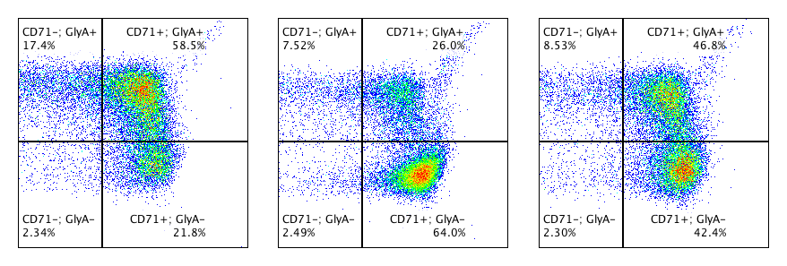
Supp. Figure 1. Validation of experimental positive controls. (A) Representative western blot of positive control protein knockdown after transfection with sgRNAs. β-actin loading control. (B) Editing efficiency of control sgRNAs, n = 8. (C) Proliferation time course normalized to AAVS1. Significance determined by RM 2-way ANOVA with Geisser-Greenhouse correction and Dunnett’s multiple comparisons test, n = 6. (D) AAVS1 normalized erythroid differentiation after 14 days in culture. Significance determined by paired t-test, n = 6. (E) Representative flow plots of 14-day erythroid differentiation cultures with positive control sgRNAs.
A.
B.
C.
sgAAVS1
sgGATA1
sgAAVS1
sgPTEN
GATA1
PTEN
β-actin
β-actin
D.
E.
sgAAVS1
sgGATA1
sgPTEN
GlyA
Mature
Mature
Mature
Immature
Immature
Immature
CD71
Notes:
Supp. Figure 1. Validation of experimental positive controls. (A) Representative western blot of positive control protein knockdown after transfection with sgRNAs. β-actin loading control. (B) Editing efficiency of control sgRNAs, n = 8. (C) Proliferation time course normalized to AAVS1. Significance determined by RM 2-way ANOVA with Geisser-Greenhouse correction and Dunnett’s multiple comparisons test, n = 6. (D) AAVS1 normalized erythroid differentiation after 14 days in culture. Significance determined by paired t-test, n = 6. (E) Representative flow plots of 14-day erythroid differentiation cultures with positive control sgRNAs.

Slide 4
Supp. Figure 2. Genes in high proliferation group show expansion of edited cells. Genes were evenly split into low, mid, and high groups based on AAVS1 normalized proliferation. Change in the percentage of edited alleles before and after expansion in 7-day proliferation culture, significance determined by One-way ANOVA and Tukey’s multiple comparisons test.
Notes:
Supp. Figure 2. Genes in high proliferation group show expansion of edited cells. Genes were evenly split into low, mid, and high groups based on AAVS1 normalized proliferation. Change in the percentage of edited alleles before and after expansion in 7-day proliferation culture, significance determined by One-way ANOVA and Tukey’s multiple comparisons test.

Slide 5
Supp. Figure 3. Proliferation assay time course. Proliferation time course normalized to AAVS1 on day 3 (first measurement). n=167.
E.
Notes:
Supp. Figure 3. Proliferation assay time course. Proliferation time course normalized to AAVS1 on day 3 (first measurement). n=167.

Slide 6
Supp. Figure 4. Correlation of proliferation assay biological replicates. Heat map of Pearson r correlation coefficients for each biological replicate.
Notes:
Supp. Figure 4. Correlation of proliferation assay replicates. Heat map of Pearson r correlation coefficients for each biological replicate.

Slide 7
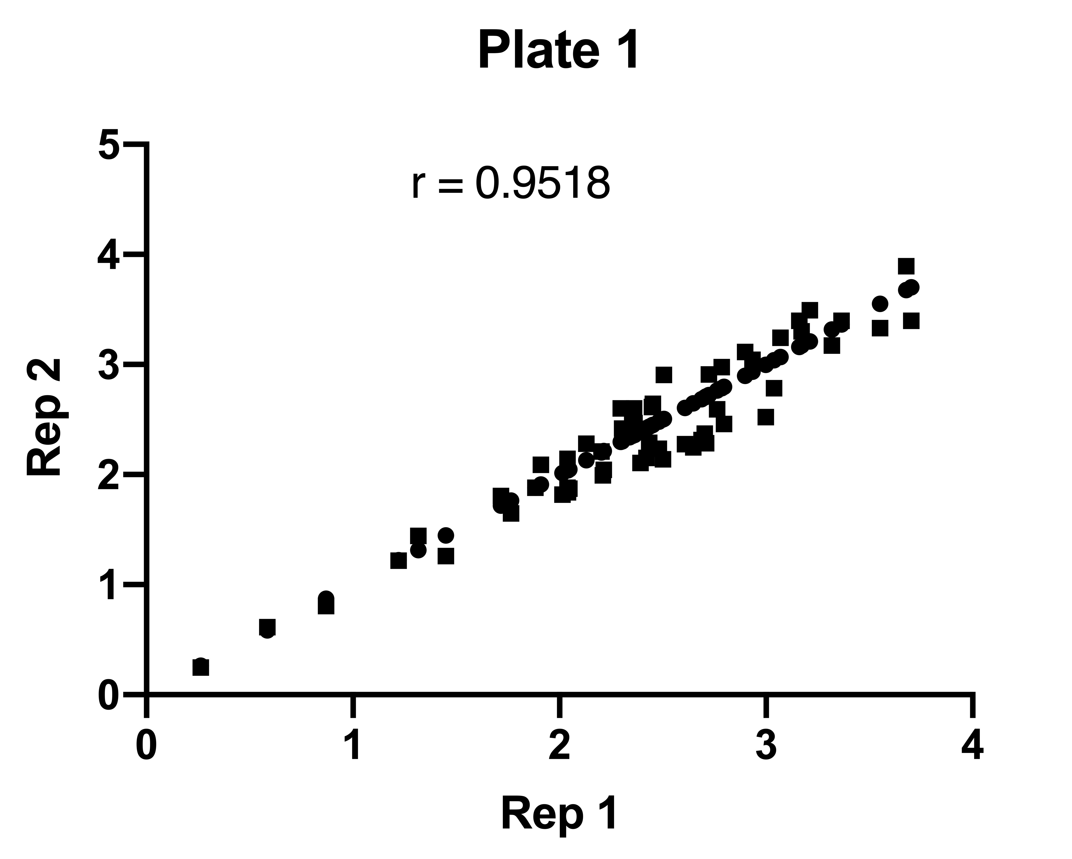
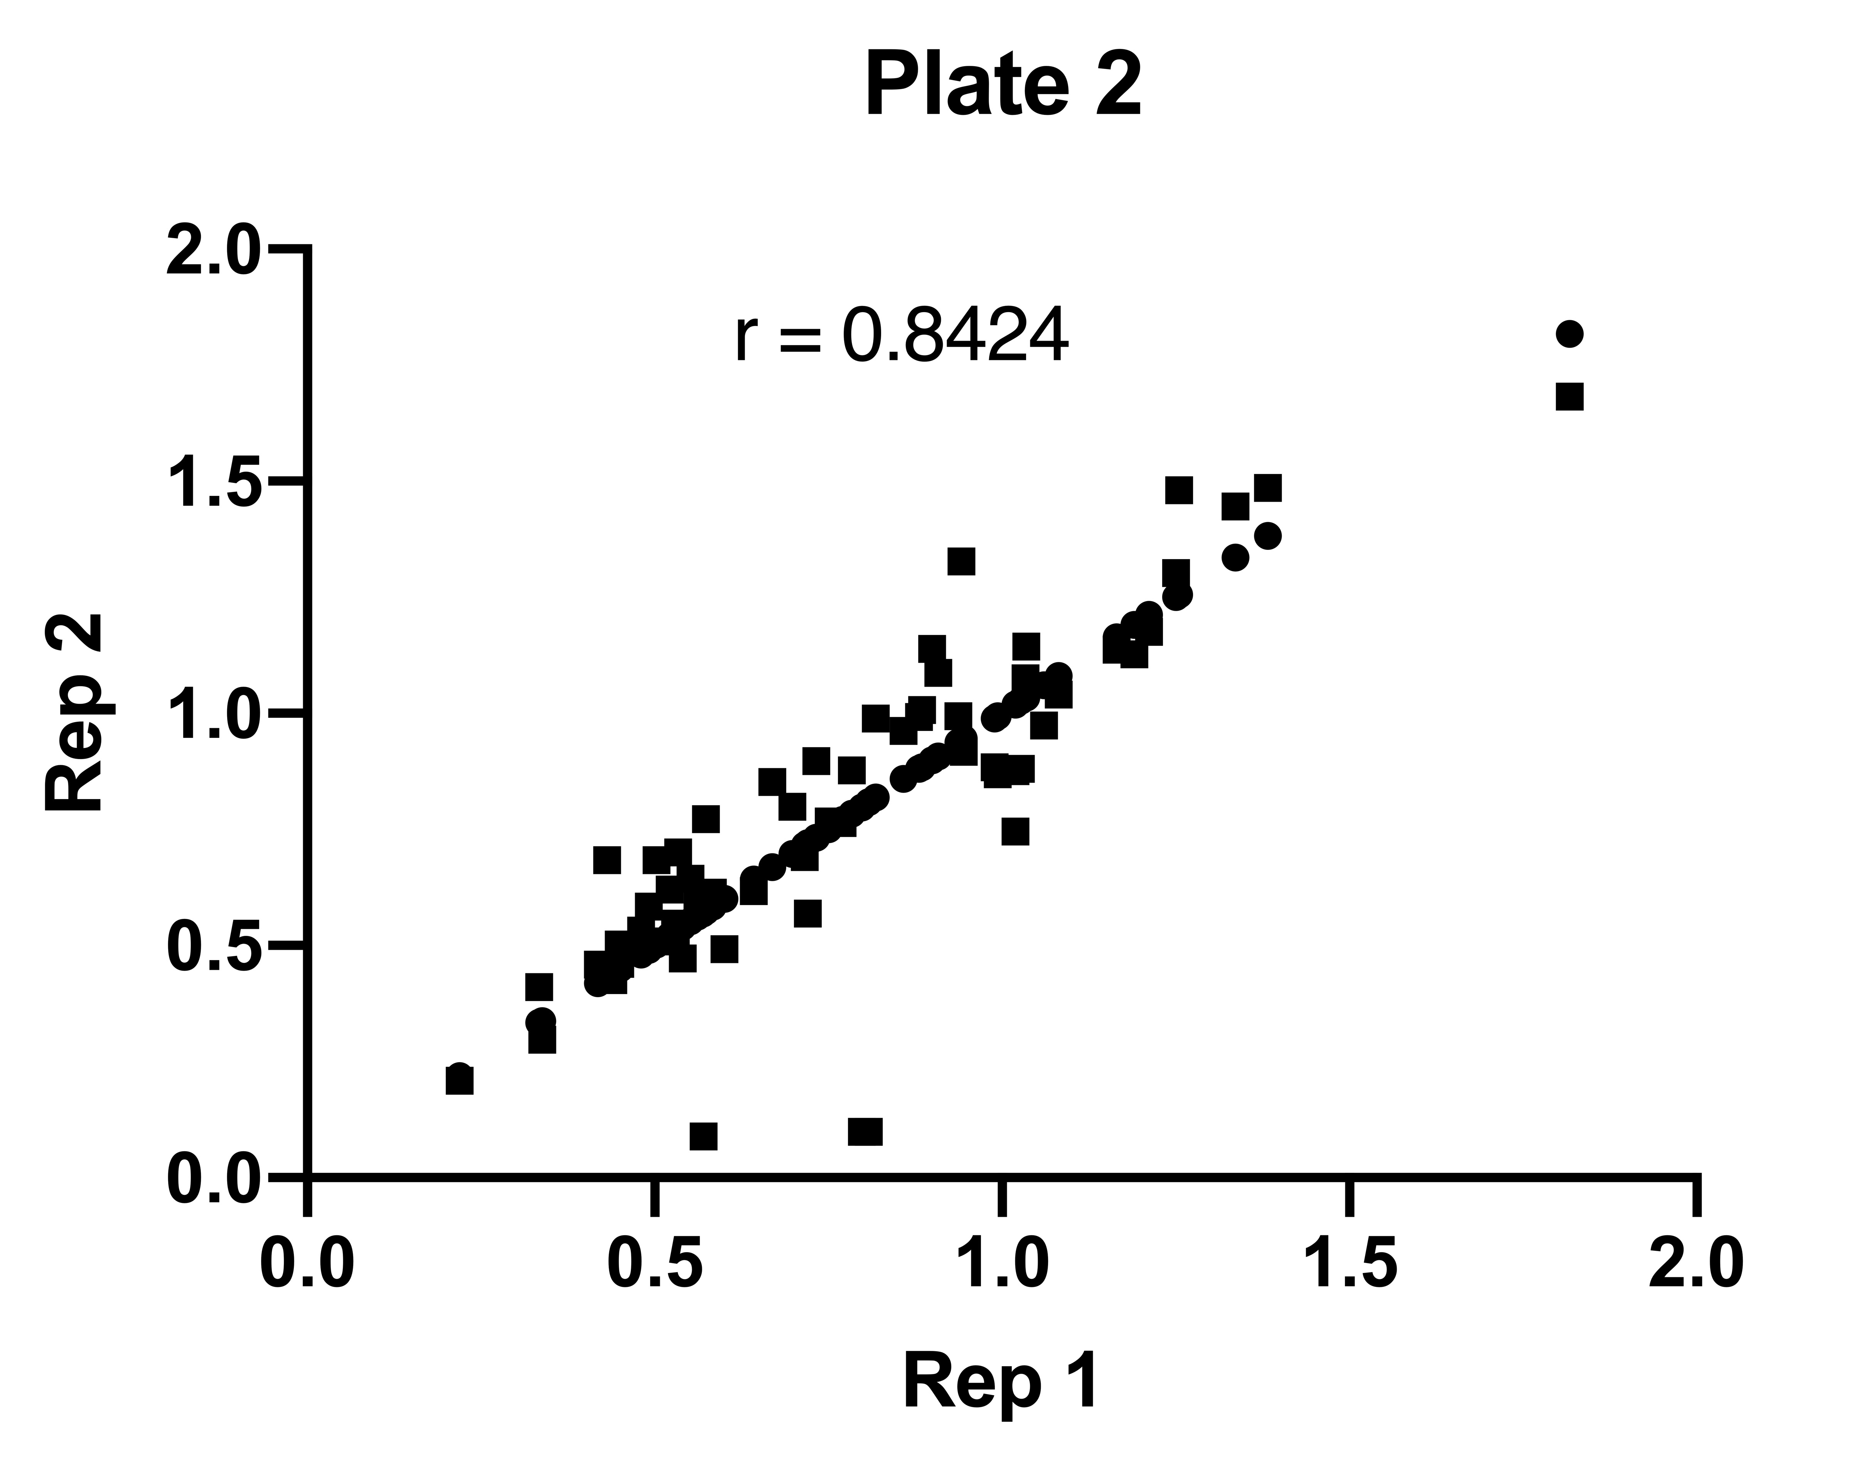
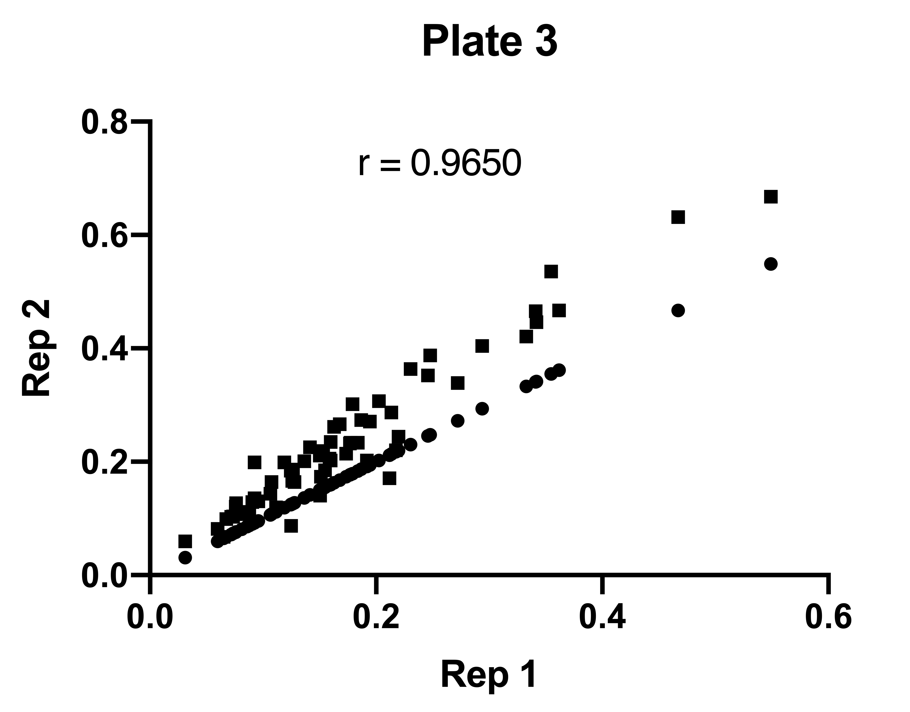
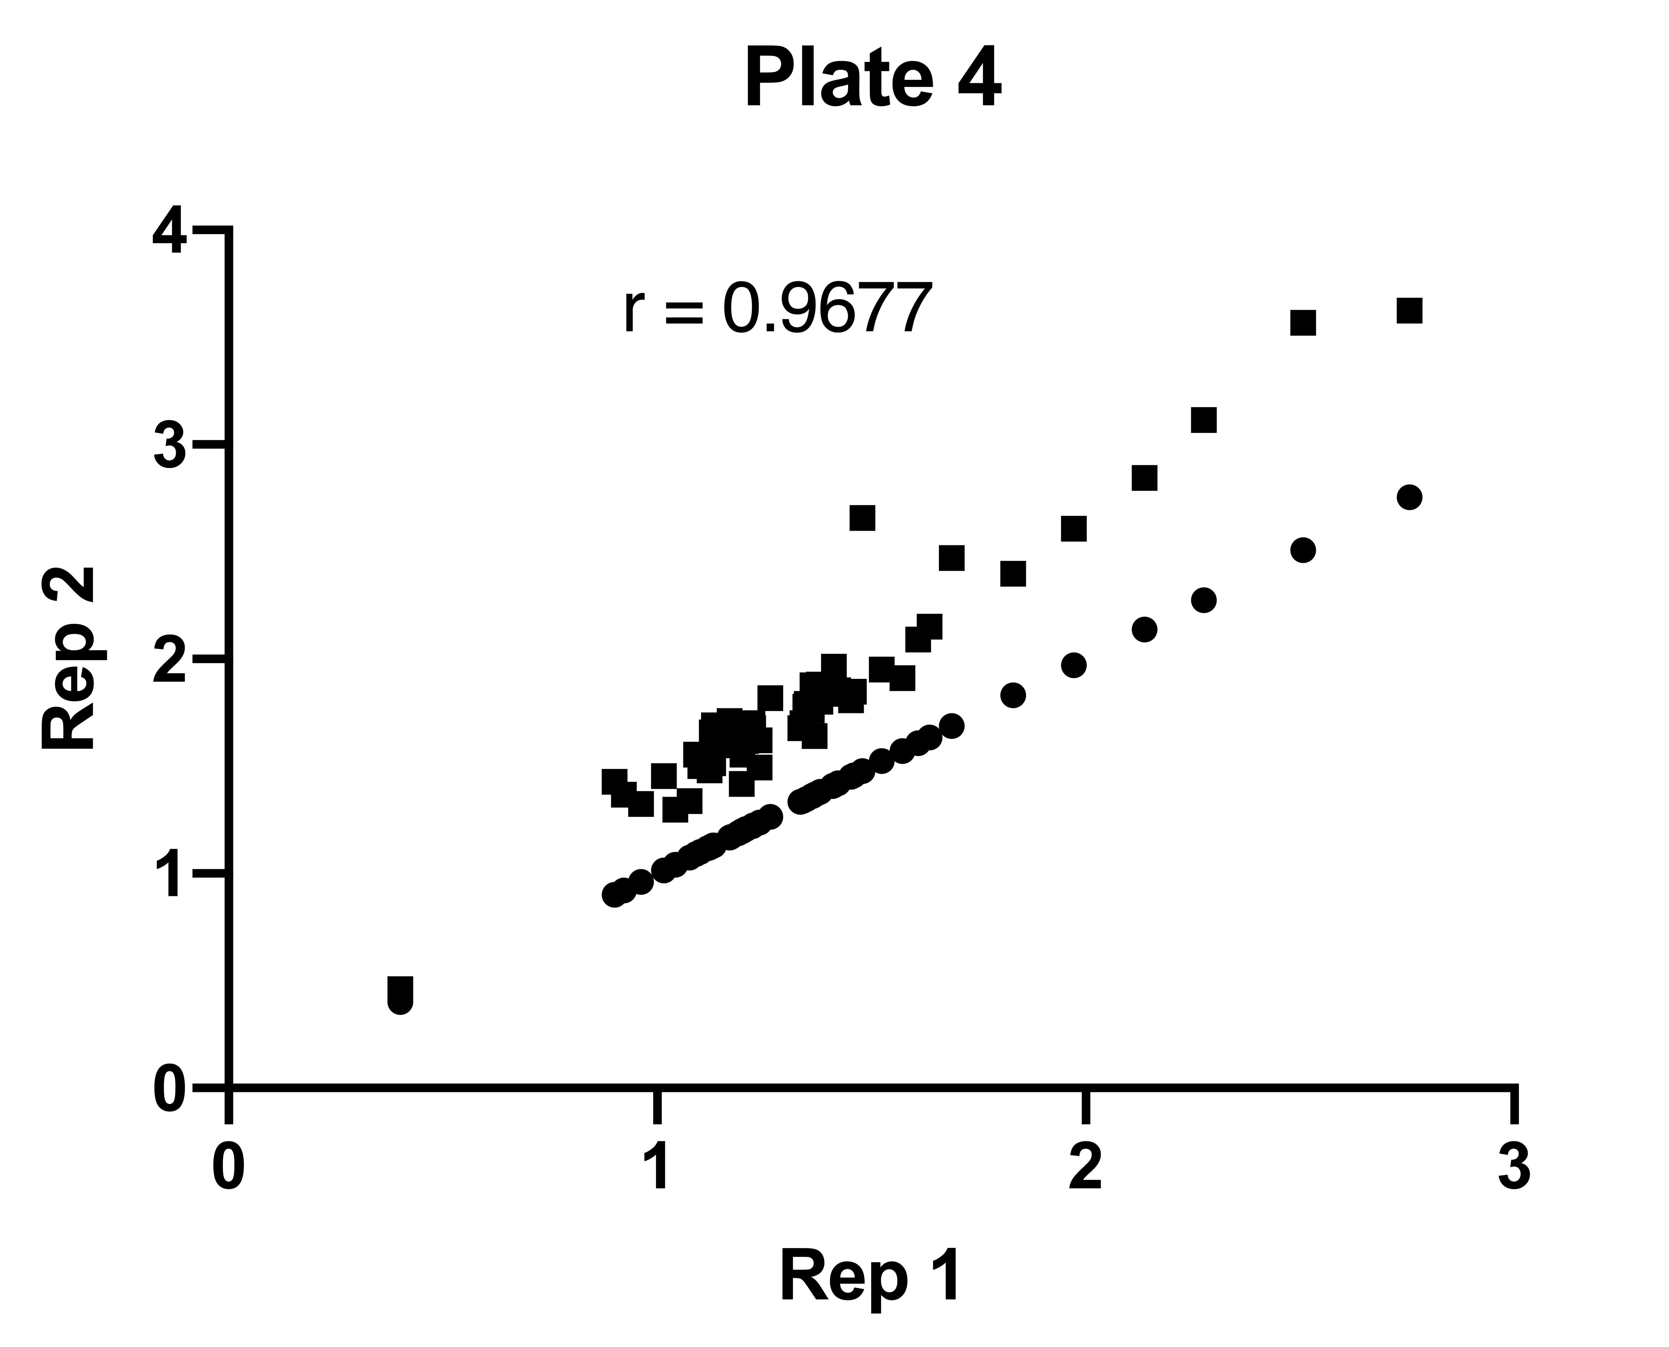
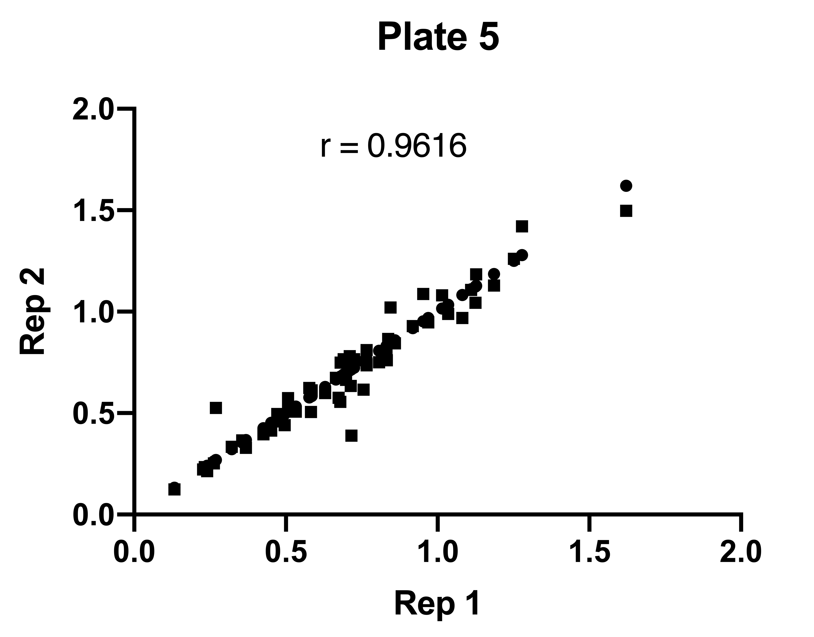
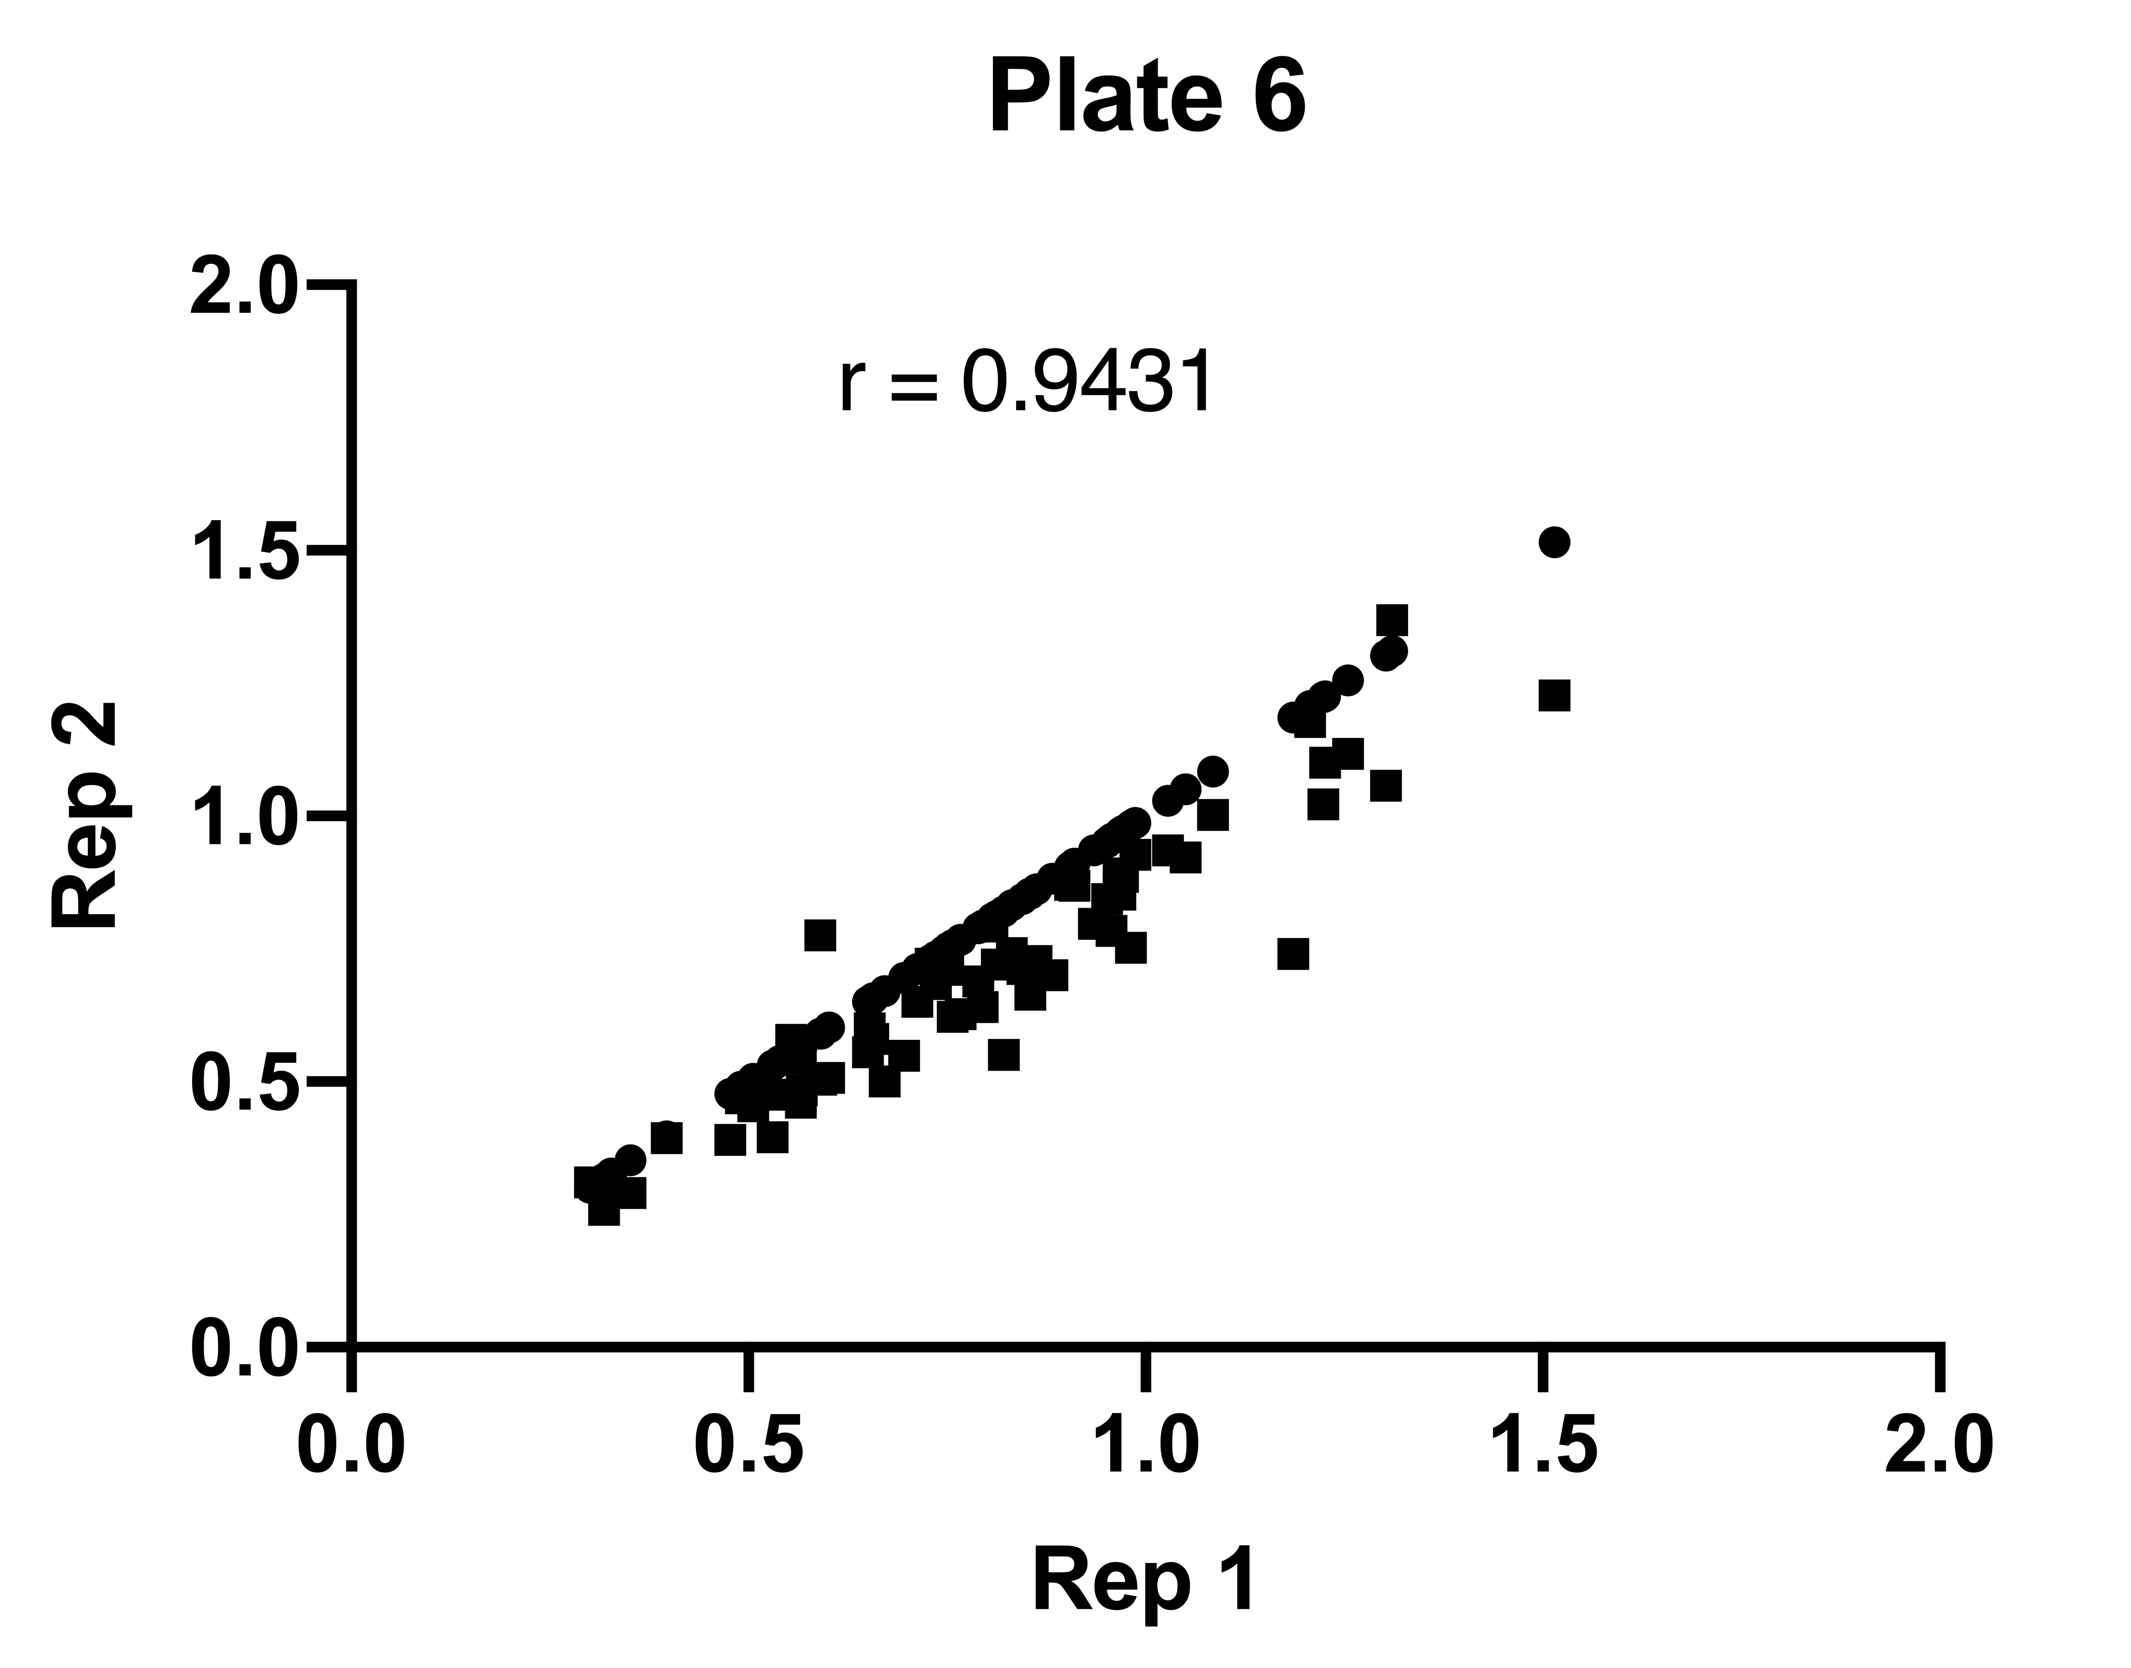
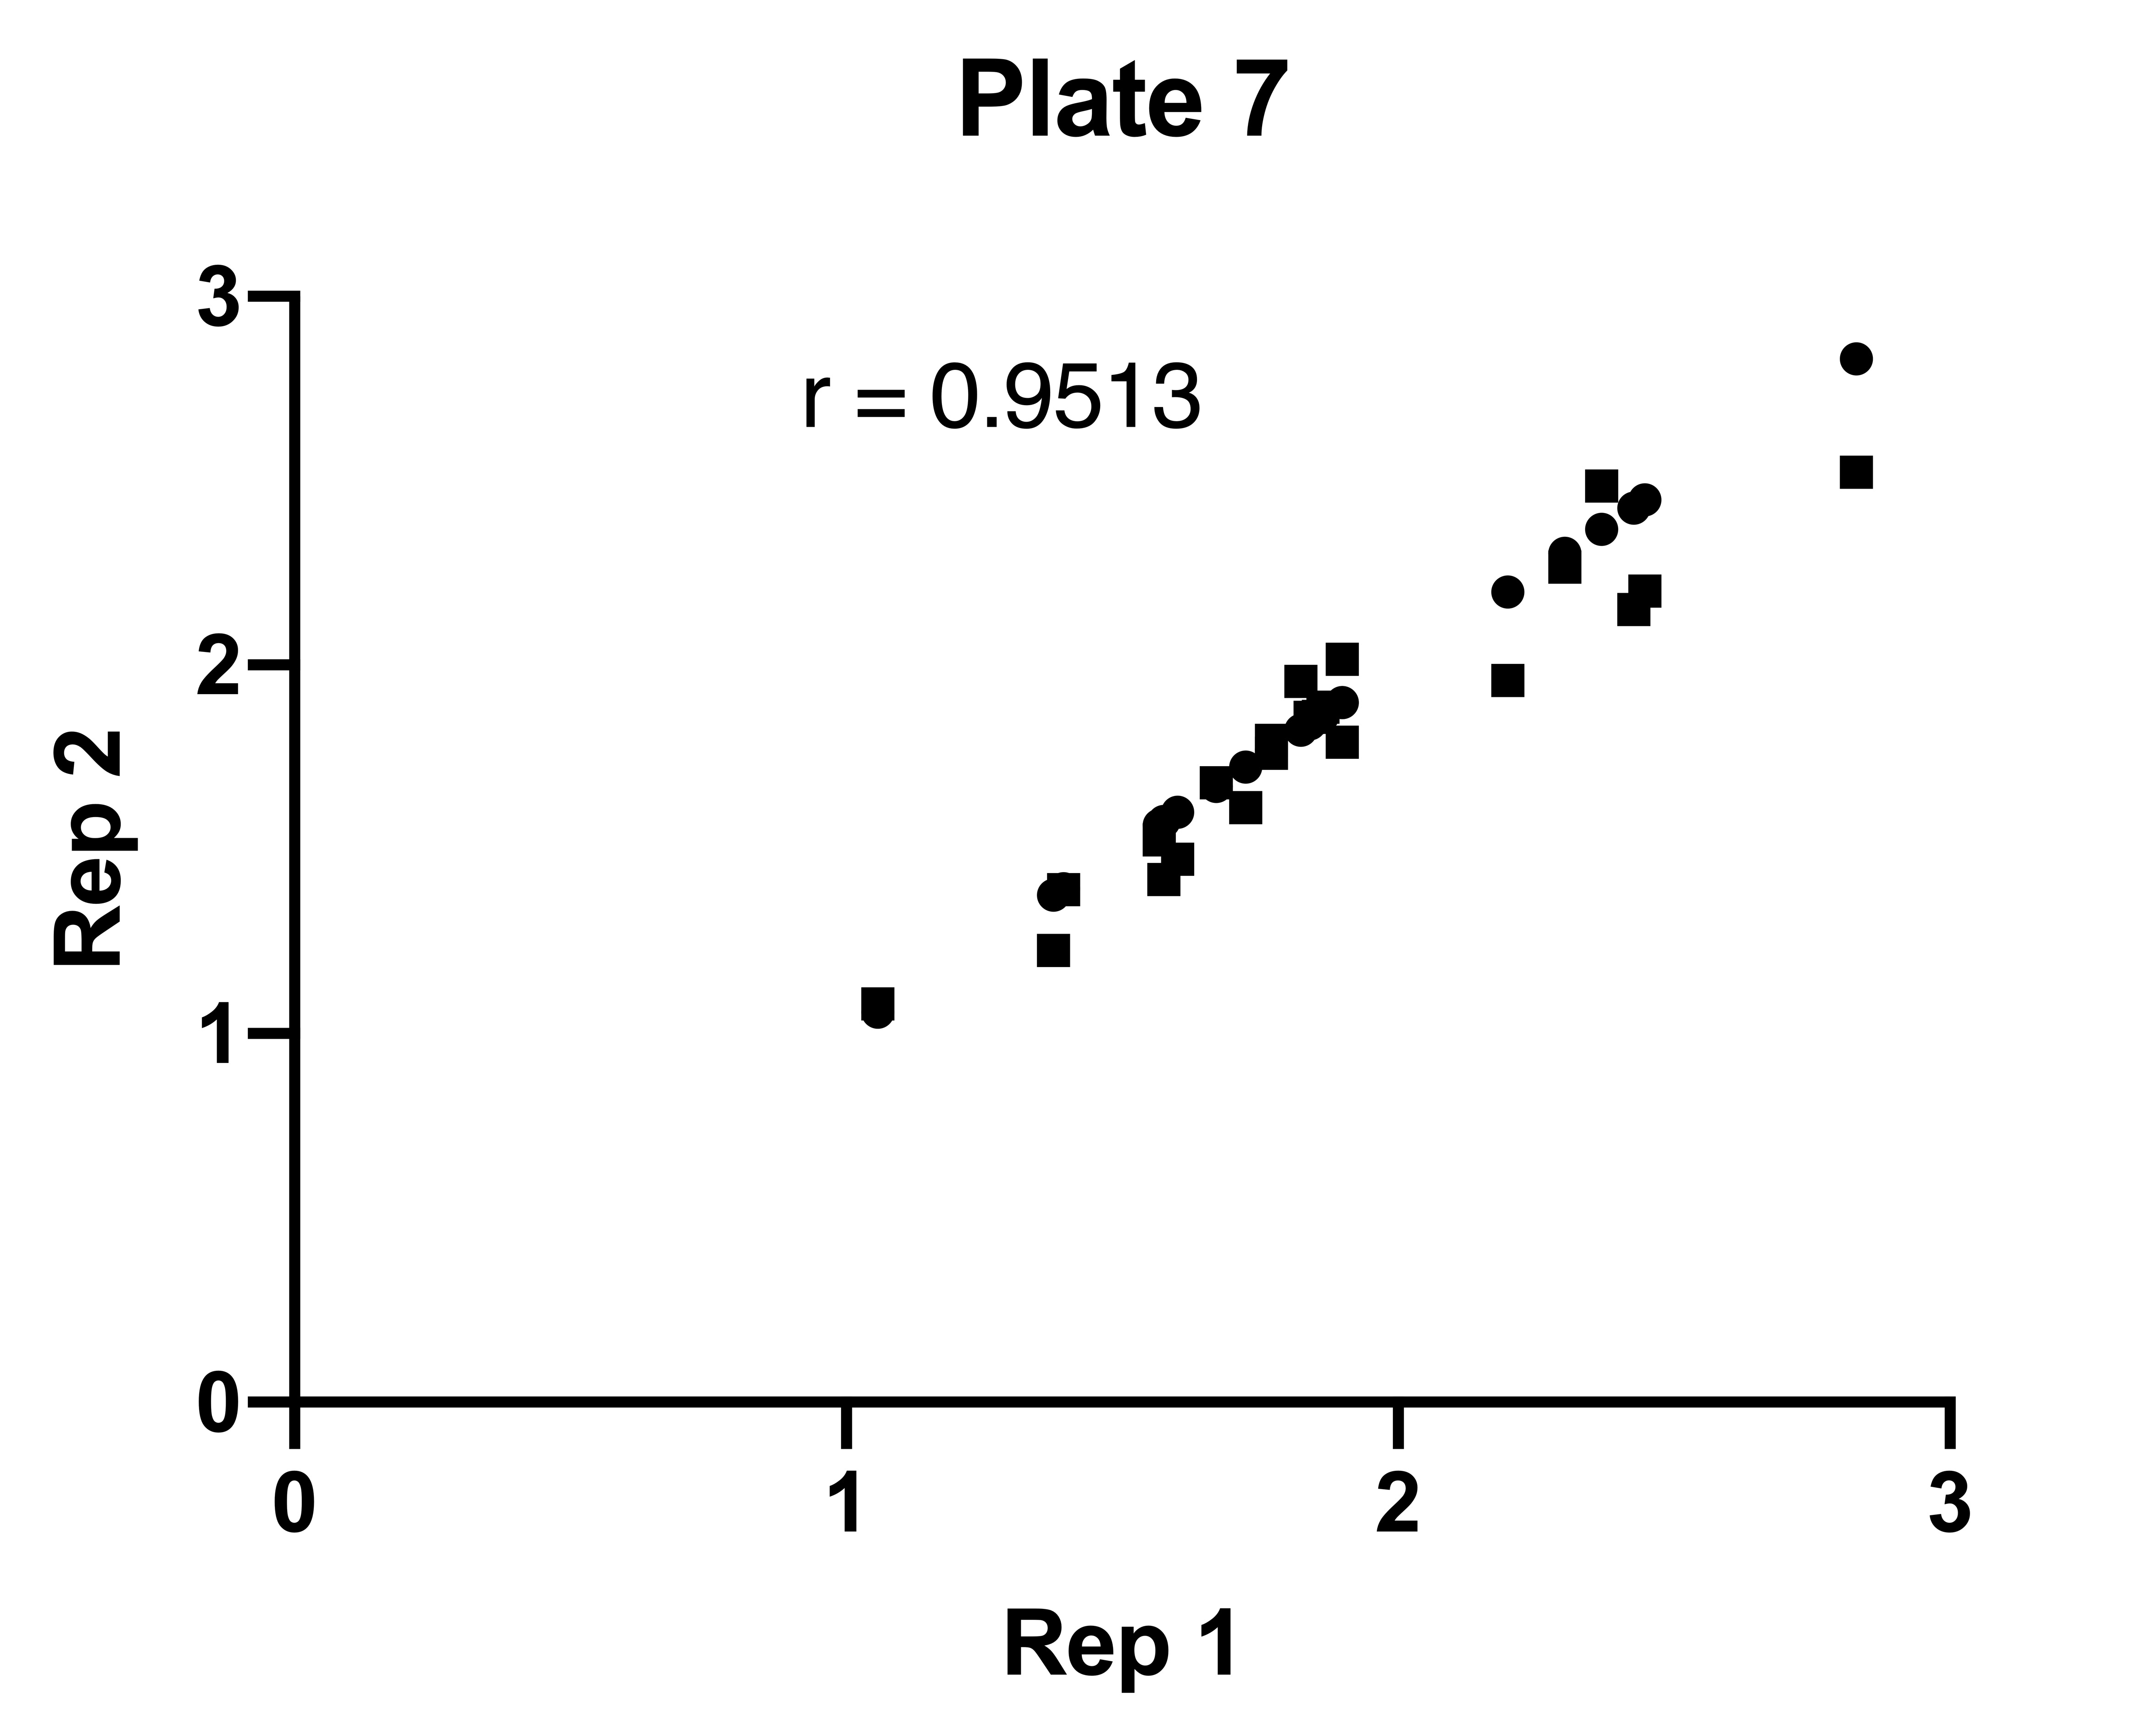
Supp. Figure 5. Correlation of proliferation assay technical replicates. Pearson r correlation coefficients for technical replicates (Rep 1 vs Rep 2) within each biological replicate (Plates 1-7).

Slide 8
Supp. Figure 6. Correlation of erythroid differentiation assay biological replicates. Heat map of Pearson r correlation coefficients for each biological replicate.

Slide 9
Supp. Figure 7. Design of machine learning tumor suppressor classification. Flow chart depicting design of random forest machine learning model for prediction of chromosome 7 tumor suppressor genes.
Training Data (all non-Chr7 genes)
Data-preprocessing and filtering
100 iterations of testing, score output by number of positive tumor suppressor identifications
“Ground Truth”
Tumor suppressor as labeled by Cancer Gene Census
29 variables in hematopoietic cell lines from 8 studies
Training-testing data split by bootstrapping
Testing using Random Forest on Chr7 genes
Impute missing data
Hyperparameter tuning
Mutational signature data from Davoli et al., 2013
Performance assessment

Slide 10
Supp. Figure 8. Quality control measures for machine learning model. (A) Importance of each variable on classification. (B) AUC (Area Under The Curve) ROC (Receiver Operating Characteristics) curve.
A.
B.
need updated with better labels from Weihan

Slide 11
Supp. Figure 9. Genes included in arrayed screen are overall enriched for tumor suppressor activity. Frequency distribution of (A,C) proliferation normalized to AAVS1 or (B,D) combined score for all genes (A,B) or genes in top 15% by machine learning classification score. Significance of the median increase over AAVS1 control determined by Wilcoxon signed-rank test, n = 108 (A,B); n = 29 (C,D).
A.
B.
C.
D.

